Slide 1

DriverPass System Analysis
Jodie Snodgrass

Slide 2

System Requirements
Functional requirement: User learning materials || The student should have the ability to access tests and use them. The tests should show progress.
Functional requirement: Appointments for driving lessons || The student should be shown a list of options with date and times available for lessons. Unavailable times should not be offered.
Non-functional requirement: Cloud-based environment || The system should be able to be accessed on any platform as long as internet connected.
Non-functional requirement: Available times || The system should not show times for booking driving lessons if the times are not available.

Slide 3
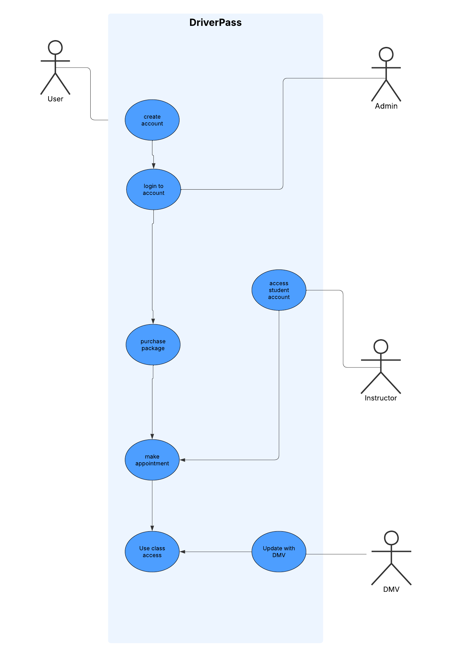
Use Case Diagram
For the DriverPass system four different individuals are involved in the process being user, instructor, admin, and DMV source. This diagram shows how the user creates an account and then logs in. Admin also connects with login in case of forgotten password. The following use cases as in order of purchase package, make appointment, use class access (which includes study materials and tests progress). Also, on the chart from the DMV source use class access is kept up to date. The instructor can access student account to create appointments for driving lessons.

Slide 4
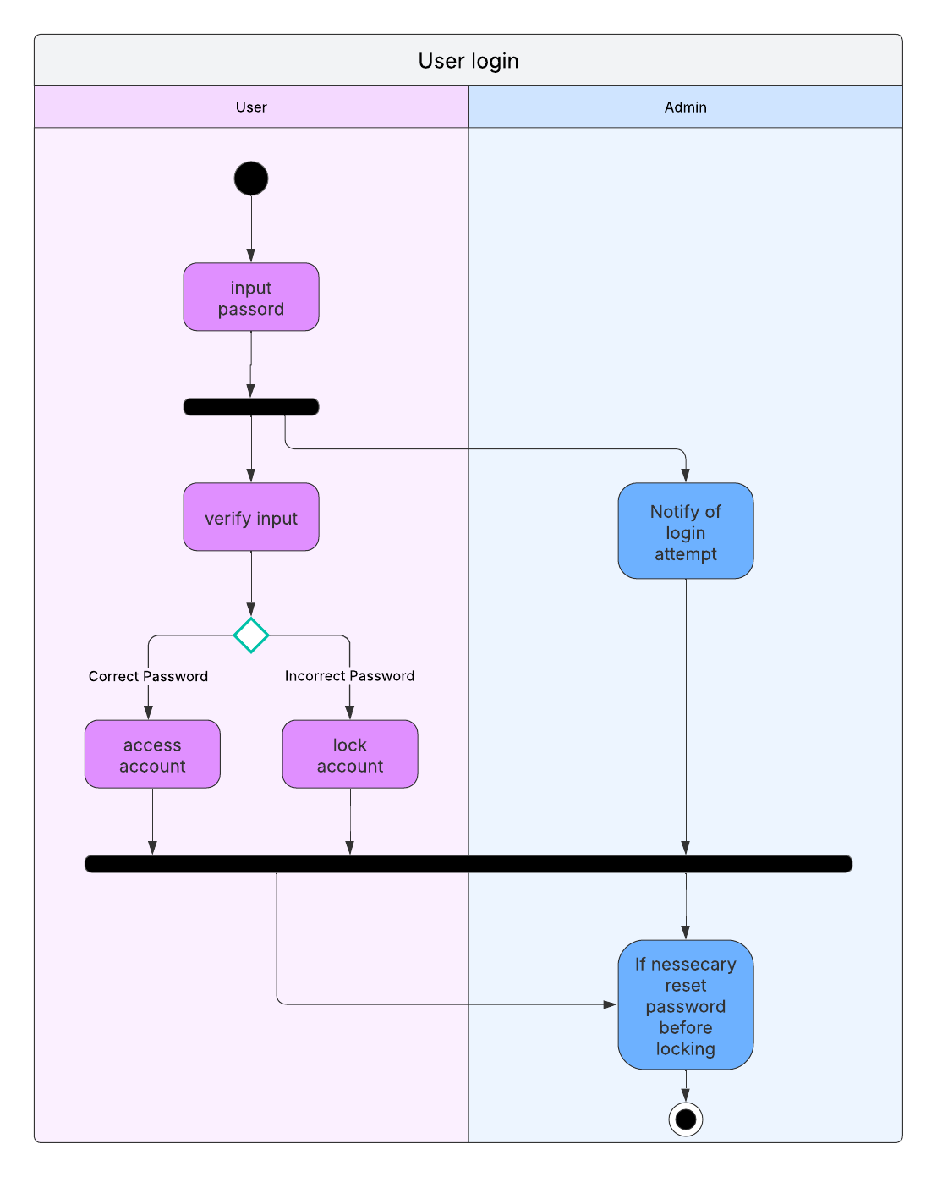
Activity Diagram
In this diagram it displays user login process. Parties involved include user and admin. Once user has input password information is verified and if the input password is correct the user can access account. If the password is incorrect after many attempts the account is locked. Before locking the account the user can request reset password which would be performed by the admin.

Slide 5
Security
There are a couple security features in my design.
Verify login
Account lock
Reset password
With these security features the user must verify it is the user who is trying to login. This can be done through conformation means such as text, calls or emails and reCAPTCHA. If the user forgets password they can reset after verifying they are the user making the request before the account is locked after 3 tries of incorrect password.

Slide 6
System Limitations
The users must have internet access to purchase packages, use learning materials, and see times for available lessons.
There are only 10 cars. With more customers there would need to be more employees and cars. This creates a budget limit.
The system must be powerful enough to support many users online all at once with lagging or crashing.

